Slide 1

Supabase Testing Facility
Daniel Broomhead

Slide 2
Background.
This project was set up with the sole purpose of testing the capabilities, implementations and possibilities of supabase within svelte.
The initial thought was that a simple shop would allow me to test a variety of features and functionality and could be extended over time.
It is also useful in the long run, as a shop is something that I will most likely need.

Slide 3

Setting up the Database.
While the Supabase UI is extremely easy to use, the ability to set up the database using SQL really appealed to me, it meant that I would be able to streamline processes in the future and make the process repeatable and likely automatable.
That being said – not all of it could be done online ( or maybe it can – I’m sure theres a CLI / API interface.)

Slide 4
Creating a Supabase Project
1. Create a Supabase Project
Go to the Supabase website and sign up or log in.
Create a new project:
On your Supabase dashboard, click New Project.
Choose a project name, and select the region closest to you.
Set a password for your database (this is important for later, but you won’t be using it in your app).
Click Create new project.

Slide 5
Get your Supabase credentials:
Once your project is created, go to the Project Settings.
01
Under the API section, you’ll find:
02
URL: This is the base URL for your Supabase instance.
Anon key: This is the public key used for authentication and accessing data.
Copy both the URL and Anon key. You’ll use these to configure the Supabase client in your SvelteKit project.
03

Slide 6
Install Supabase Client in SvelteKit
npm install @supabase/supabase-js

Slide 7
Set Up Environment Variables
Create a .env file in the root of your SvelteKit project. This is where you’ll securely store your Supabase credentials (so they aren't exposed in your code).
".env"
Add the following two lines.
VITE_SUPABASE_URL=your_supabase_url
VITE_SUPABASE_ANON_KEY=your_anon_key

Slide 8
src/lib/supabase.js
In, src/lib/supabase.jsadd the following code: (or src/supabase/supabase.js)
// Import the createClient method from the supabase-js library
import { createClient } from '@supabase/supabase-js';
// Load environment variables from .env file
const SUPABASE_URL = import.meta.env.VITE_SUPABASE_URL;
const SUPABASE_ANON_KEY = import.meta.env.VITE_SUPABASE_ANON_KEY;
// Create a single supabase client instance
export const supabase = createClient(SUPABASE_URL, SUPABASE_ANON_KEY);

Slide 9
Add a (products) table.
Go to the Table Editor in your Supabase project and create a table with columns like id, name, description, price, etc.
Alternatively use SQL
-- Create the products table
CREATE TABLE products (
id SERIAL PRIMARY KEY, -- Auto-incrementing primary key
name VARCHAR(255) NOT NULL, -- Product name, required
description TEXT, -- Product description, optional
price DECIMAL(10, 2) NOT NULL, -- Product price, required with two decimal points
created_at TIMESTAMPTZ DEFAULT now(), -- Timestamp of creation, default to current time
updated_at TIMESTAMPTZ DEFAULT now() -- Timestamp for last update, default to current time
);
-- Optionally, you can create an index for faster searches by name
CREATE INDEX idx_products_name ON products (name)

Slide 10
src/routes/index.svelte file (see notes for full code)
<script>
// Import the supabase client to access your database
import { supabase } from '$lib/supabase’;
// Use the Supabase client to fetch all products from the 'products' table
const { data, error } = await supabase.from('products').select('*');
if (error) {
console.error('Error fetching products:', error.message);
} else {
// If successful, store the products in the 'products' variable
products = data;
</script>
Notes:
<script>
// Import the supabase client to access your database
import { supabase } from '$lib/supabase';
// Declare a variable to store the products data
let products = [];
// Fetch the products when the component is mounted
const fetchProducts = async () => {
// Use the Supabase client to fetch all products from the 'products' table
const { data, error } = await supabase.from('products').select('*');
if (error) {
console.error('Error fetching products:', error.message);
} else {
// If successful, store the products in the 'products' variable
products = data;
}
};
// Call the fetchProducts function when the component is mounted
fetchProducts();
</script>
<h1>Product List</h1>
<!-- Display the products dynamically -->
<ul>
{#each products as product (product.id)}
<li>
<h3>{product.name}</h3>
<p>{product.description}</p>
<p>Price: ${product.price}</p>
</li>
{/each}
</ul>

Slide 11
Display // access properties
<h1>Product List</h1>
<!-- Display the products dynamically -->
<ul>
{#each products as product (product.id)}
<li>
<h3>{product.name}</h3> <!-- standard dot notation -->
<p>{product.description}</p>
<p>Price: ${product.price}</p>
</li>
{/each}
</ul>

Slide 12
Set Up Authentication <Script>
src/routes/signup.svelte file:
<script>
import { supabase } from '$lib/supabase’; let email = ‘’; let password = ‘’;
let message = ‘’; // Handle the signup process
const signUp = async () => {
const { user, error } = await supabase.auth.signUp({ email, password });
if (error) {
message = `Error: ${error.message}`;
} else {
message = `Sign-up successful! Welcome, ${user.email}`;
}
};
</script>

Slide 13
Set up authentication <Form>
<h1>Sign Up</h1>
<form on:submit|preventDefault={signUp}>
<label for="email">Email:</label>
<input type="email" id="email" bind:value={email} required />
<label for="password">Password:</label>
<input type="password" id="password" bind:value={password} required />
<button type="submit">Sign Up</button>
</form>
<p>{message}</p>

Slide 14
RLS – Row Level Security
After creating your table, go to Policies under the table settings.
Enable Row-Level Security (RLS) for the table to control which users can read or modify the data.
Create Policies (if you need control over data access):
For example, to allow only authenticated users to view products:
CREATE POLICY "authenticated users can view products“
ON products
FOR SELECT
USING (auth.uid() IS NOT NULL);

Slide 15
Important Notes:
Policies:
Supabase uses the PostgREST API, and Row-Level Security (RLS) is a powerful feature. When RLS is enabled, all access to the table is restricted until you define policies.
Authentication:
The auth.uid() function references the authenticated user's ID, which is important when creating policies for user-specific access.
Roles:
You may have different roles like role_admin for admins. You can define roles in Supabase's Authentication settings or manually create them in the database.
Best Practice:
When working with policies and RLS, make sure to carefully test the security configurations to ensure you aren't exposing sensitive data.

Slide 16
Why Protect Pages?
Restrict access to authenticated users
Prevent unauthorized access to admin or user-only areas
Improve security by enforcing login checks
Manage user roles (e.g., admin vs. regular user)

Slide 17
How Protected Pages Work
1. User tries to access a protected page
2. Check if user is authenticated via Supabase
3. If authenticated, allow access
4. If not, redirect to login page

Slide 18
Best Practices for Securing Pages
Check
Always check authentication on the server (`+page.server.js`)
Redirect
Redirect unauthorized users to a login page
Use
Use Supabase row-level security (RLS) for extra data protection
Store
Store session securely, avoid exposing JWT tokens in the frontend

Slide 19
Code: src/routes/protected/+layout.server.ts
import { redirect } from '@sveltejs/kit';
import { supabase } from '$lib/supabase';
export const load = async ({ locals }) => {
// Get the current authentication session from Supabase
const { data: { session } } = await supabase.auth.getSession();
// If no user session is found, redirect to the login page
if (!session) {
throw redirect(303, '/login');
}
// Return the authenticated user to be accessible in `page.data`
return { user: session.user };
};

Slide 20
How This Works:
✅ Runs on the server before rendering the page.
✅ Ensures all routes under /protected/ are restricted (e.g., /protected/dashboard, /protected/settings).
✅ Redirects unauthenticated users to /login.
✅ Efficient because it runs before loading any page content.

Slide 21
Protecting Routes on the Client Side
src/routes/protected/+layout.svelte
<script>
import { page } from '$app/stores';
let user;
// Reactively check if the user is authenticated
$: if (!$page.data.user) {
window.location.href = '/login'; // Redirect to login if no user is found
}
</script>
<!-- Render the child routes -->
<slot />
This is client-side protection so should be avoided at all costs.

Slide 22
How this works?:
✅ Runs on the client after the page has loaded.
✅ Checks authentication and redirects if needed.
✅ Less efficient than server-side protection (+layout.server.ts) because the page might briefly load before redirecting.

Slide 23
Comparison
Approach | Best Use Case
+layout.server.ts (server-side) ✅ | Protecting all child routes before rendering (better performance).
+layout.svelte (client-side) 🚫 | Only useful if you can't use +layout.server.ts (not recommended).
Best Practice: Always prefer +layout.server.ts for authentication checks to prevent unauthorized access before a page loads.

Slide 24
Guard Component
This component is used to protect a page or group of routes by checking if the user is authenticated. If no user is found, it redirects them to the login page.
How This Works:
Imports $page from $app/stores
$page is a SvelteKit store that holds route-related data, including the user from +layout.server.ts if authentication is handled on the server.
Declares user
This variable is not explicitly used in the code but could be utilized for future enhancements.
Reactive Statement ($: block)
This runs whenever $page.data.user changes.
If $page.data.user is null or undefined, the user is redirected to /login using window.location.href.
Uses <slot /> to Render Content
This allows child pages (e.g., /protected/dashboard, /protected/settings) to be displayed only if the user is authenticated.
This is client-side protection so should be avoided at all costs.

Slide 25
+Layout.server.ts vs +page.server.ts
+layout.server.ts
Protects Multiple Pages at Once
When placed in +layout.server.ts, authentication logic applies to all child routes.
Example: If /dashboard/+layout.server.ts checks authentication, all pages under /dashboard/* will be protected.
This avoids redundant checks on every page.
+page.server.ts Only Protects a Single Page
If authentication is in +page.server.ts, it only applies to that specific page.
Example: Protecting /dashboard/+page.server.ts won’t automatically protect /dashboard/settings
+page.server.svelte is for Server-Side Rendering, Not Access Control
+page.server.svelte is mainly for rendering server-side data, not for protecting routes.
If used for authentication checks, a user might still see part of the page before being redirected.

Slide 26
Designing the Store - Pages
Home
Products
Products/[id]
MyAccount
UpdateDetails
Basket
Checkout
Login
Signup

Slide 27
Home
As this is a simple proof of concept, the home page doesn’t need to be anything special.
Ideally it would tell us if we are logged in or not. And provide navigation to other parts of the website.
Realistically, these components could be common across the entire site.

Slide 28
Products & products/[id]
This should retrieve the products from the database, and display them in a classic store like fashion.
Each product should have its own dynamically generated page which includes all the necessary details and allows the user to add the item to the basket.

Slide 29
Generating dynamic pages in svelte
src/
├── routes/
│├── products/
││├── [id]/
│││├── +page.svelte(Dynamic Page)
│││├── +page.server.ts (Server-side Data Fetching)
│││├── +layout.svelte(Optional Layout)
│││├── +layout.server.ts (Optional Auth Guard)
Example folder structure .

Slide 30
The Dynamic Page:/[id]/+page.svelte
<script>
import { onMount } from 'svelte’; import { page } from '$app/stores’; import { supabase } from '$lib/supabase’;
let product = null;let errorMessage = ‘’;
// Function to fetch product details from Supabase//check for error.
const fetchProduct = async (productId) => {
const { data, error } = await supabase.from('products’)
.select('*’)
.eq('id', productId)
.single();
if (error) {
errorMessage = `Error: ${error.message}`;
} else { product = data;}
};
// Fetch the product when the component loads
onMount(() => {
const productId = $page.params.id;// Get 'id' from URL
fetchProduct(productId);
});
</script>

Slide 31
Fetching Data Server-Side (+page.server.ts)
import { error } from '@sveltejs/kit’;import { supabase } from '$lib/supabase';
export const load = async ({ params }) => {
const productId = params.id;
// Fetch product from database
const { data: product, error: fetchError } = await supabase
.from('products’)
.select('*’)
.eq('id', productId)
.single();
if (fetchError || !product) {
throw error(404, 'Product not found’);
}
return { product };
};

Slide 32
What each file does:
+page.svelte
+page.server.ts
✅$page.params.id → Gets the product ID from the URL
✅ fetchProduct(id) → Fetches the product from Supabase
✅ onMount() → Runs the function when the component first loads
✅ Error handling → Displays an error message if the product doesn’t exist
✅ More secure – Data is fetched on the server, avoiding exposing database logic on the client
✅ Faster – Pages can be preloaded on the server instead of waiting for client-side fetch
✅ Less flickering – No need for a loading state since the page is fully loaded before displaying

Slide 33
Displaying Data from +page.server.ts
When using +page.server.ts, the fetched data is available in $page.data.
This means we can change our +page.svelte :
Advantages of This Approach
✅ No need for onMount() or client-side fetching
✅ More efficient and scalable

Slide 34
New : /[id]/page.svelte
<script>
import { page } from '$app/stores’;
// Access product data from server
let product = $page.data.product;
</script>
{#if product}
<div class="product-detail">
<h2>{product.name}</h2>
<img src="{product.image_url}" alt="{product.name}" class="product-image" />
<p>{product.description}</p>
<p><strong>Price:</strong> £{product.price}</p>
<button>Add to Basket</button>
</div>
{/if}

Slide 35
Adding a Dynamic Layout (+layout.svelte)
If all product pages share the same layout (e.g., styling, navigation, authentication checks), create a +layout.svelte file.
What This Does:
✅ Shared styling for all product pages
✅ Wraps product pages in a div for consistent layout
✅ Shared authentication for all product pages

Slide 36
Generating Links to Dynamic Pages
To navigate between products dynamically, use:
<a href="/products/{product.id}">View Product</a>
✅ SvelteKit automatically generates URLs for each product
💡 Dynamic pages allow SvelteKit to fetch and display data based on the URL
💡 Use +page.server.ts instead of client-side fetching for better security & performance
💡 Layouts (+layout.svelte) help create consistent page structures

Slide 37
Child pages and layout sharing
src/
├── routes/
│ ├── +layout.svelte<-- Global Layout
│ ├── index.svelte<-- Home Page
│ ├── about/
│ │├── +page.svelte<-- Uses the global layout
│ ├── products/
│ │├── +layout.svelte<-- Layout specific to products
│ │├── +page.svelte <-- Product listing page
│ │├── [id]/
│ ││├── +page.svelte<-- Dynamic product page
Example folder structure.

Slide 38

Understanding Layouts
In SvelteKit, you can share layouts, styles, and logic across multiple pages using layouts (+layout.svelte), global styles, and components.
A layout is a wrapper around multiple pages. It allows you to share UI elements (e.g., navbars, footers, styles) across different pages.
How Layouts Work
A layout file (+layout.svelte) applies to all its child pages.
Layouts automatically wrap any +page.svelte files inside them.
Nested +layout.svelte files override parent layouts.

Slide 39
Option 1: Site wide Layout
If you want consistent styling and structure (e.g., a navbar and footer across the whole site), place a +layout.svelte file in the src/routes/ folder.
Breakdown
✅ <slot /> – This is where the child page (+page.svelte) will render
✅ Global styling – Ensures a consistent font, background, and layout
✅ Navbar & Footer – Shared across all pages

Slide 40
Option 1 : Code
<script>
let { children } = $props();
</script>
<style>
body {font-family: Arial, sans-serif;margin: 0;padding: 0;background-color: #f8f8f8; }
.container {max-width: 1200px;margin: auto;padding: 20px; }
nav {background-color: #0077B6;color: white;padding: 10px;text-align: center; }
footer {background-color: #03045E;color: white;text-align: center;padding: 10px;margin-top: 20px; }
</style>
<!-- Global Navigation -->
<nav>
<a href="/">Home</a> | <a href="/about">About</a> | <a href="/products">Products</a>
</nav>
<!-- Main Page Content -->
<div class="container">
<slot />
</div>
<!-- Global Footer -->
<footer>
&copy; {new Date().getFullYear()} My Website
</footer>

Slide 41
Option 2: Nested Layouts
You can have nested layouts for different parts of the website.
Example: Layout for /products Section
Instead of every product page looking like the home page, we can create a products/+layout.svelte to customize how product pages are styled.

Slide 42
What Happens Here?/
Products and all child pages inside it (like /products/[id]) will use this layout.
It inherits the global layout (src/routes/+layout.svelte).
Custom styling for product pages is added.
✅ Nested layouts give flexibility – The product section has its own look and feel while still using the global navbar/footer.

Slide 43
Option 3:Using Global CSS (app.postcss or app.css)
src/app.css
src/routes/+layout.svelte
body {
font-family: 'Arial', sans-serif;
background-color: #f0f0f0;
margin: 0;
padding: 0;
}
a {
text-decoration: none;
color: #0077B6;
}
a:hover {
color: #00B4D8;
}
<style>
@import '$app.css';
</style>

Slide 44
Reusable Components for Consistency
Instead of repeating code for buttons, cards, modals, create components in src/lib/components.
✅ Best for buttons, modals, reusable UI elements
✅ Keeps layouts/pages simpler and cleaner

Slide 45
Component example
src/lib/components/Button.svelte
Any page/layout or reuse situation
<script>
export let label = 'Click me';
export let onClick = () => {};
</script>
<button on:click={onClick} class="custom-button">
{label}
</button>
<style>
.custom-button {
background-color: #0077B6;
color: white;
border: none;
padding: 10px 20px;
border-radius: 5px;
cursor: pointer;
transition: background-color 0.3s;
}
.custom-button:hover {
background-color: #00B4D8;
}
</style>
<script>
import Button from '$lib/components/Button.svelte';
</script>
<Button label="Buy Now" onClick={() => alert('Added to cart')} />

Slide 46
Summary
Approach | Use Case | Best Practices
+layout.svelte | Global layout (Navbar, Footer) | ✅ Keep UI elements consistent ✅ Use <slot /> properly ✅ Add global styles
Nested +layout.svelte | Section-specific layouts (e.g., /products/) | ✅ Override parent layout only when necessary ✅ Ensure it inherits needed styles
app.css or app.postcss | Global styles (fonts, resets, links) | ✅ Define base styles like typography ✅ Avoid deep selectors
Components (/lib/components/) | Reusable UI elements | ✅ Use for buttons, cards, modals ✅ Pass props for flexibility

Slide 47
Supabase – User management example.
Supabase have their own user management example.
https://supabase.com/docs/guides/getting-started/tutorials/with-sveltekit
This tutorial demonstrates how to build a basic user management app.
The app authenticates and identifies the user, stores their profile information in the database, and allows the user to log in, update their profile details, and upload a profile photo.
The app uses:
Supabase Database - a Postgres database for storing your user data and Row Level Security so data is protected and users can only access their own information.
Supabase Auth - allow users to sign up and log in.
Supabase Storage - users can upload a profile photo.

Slide 48
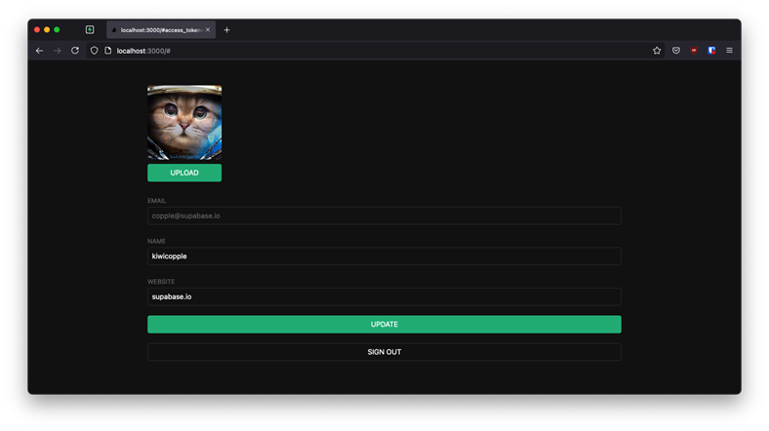
Database setup: \SQL Scripts\UserManagementExample.sql
-- Create a table for public profiles
-- Set up Row Level Security (RLS)
-- See https://supabase.com/docs/guides/database/postgres/row-level-security for more details.
-- This trigger automatically creates a profile entry when a new user signs up via Supabase Auth.
-- See https://supabase.com/docs/guides/auth/managing-user-data#using-triggers for more details.
-- Set up access controls for storage.
-- See https://supabase.com/docs/guides/storage/security/access-control#policy-examples for more details.

Slide 49
Creating a Supabase client for SSR
The ssr package configures Supabase to use Cookies, which is required for server-side languages and frameworks.
npm install @supabase/ssr @supabase/supabase-js
Creating a Supabase client with the ssr package automatically configures it to use Cookies. This means your user's session is available throughout the entire SvelteKit stack - page, layout, server, hooks.

Slide 50
Auth.getSession()
Note that auth.getSession reads the auth token and the unencoded session data from the local storage medium. It doesn't send a request back to the Supabase Auth server unless the local session is expired.
You should never trust the unencoded session data if you're writing server code, since it could be tampered with by the sender. If you need verified, trustworthy user data, call auth.getUser instead, which always makes a request to the Auth server to fetch trusted data.

Slide 51
Hooks.server.ts
A hooks.server.ts file in SvelteKit lets you run server-side code on every incoming request. It acts like a global middleware that can modify or inspect requests before they reach your page or endpoint load functions. Here are some key points:
Global Request Handling:The hook runs on every request, so you can use it to perform tasks that need to happen consistently—like logging, setting security headers, or processing cookies.
Session and Authentication Management:One common use is to read authentication tokens (typically from cookies) and attach the verified user or session data to event.locals. This makes it available in your server load functions for protecting routes or preloading data.
Middleware-Like Behavior:Think of it as middleware in other frameworks. It can decide whether to continue processing a request or redirect it (for example, to a login page) before any page logic executes.
Modifying the Response:You can also modify the outgoing response if needed, such as adding additional headers.

Slide 52
Auth:
Full blown auth. Really nail it down – work out what m trying to understand and get from it.
Play around with profiles & RBAC – plus database access rules (RLS)

Slide 53
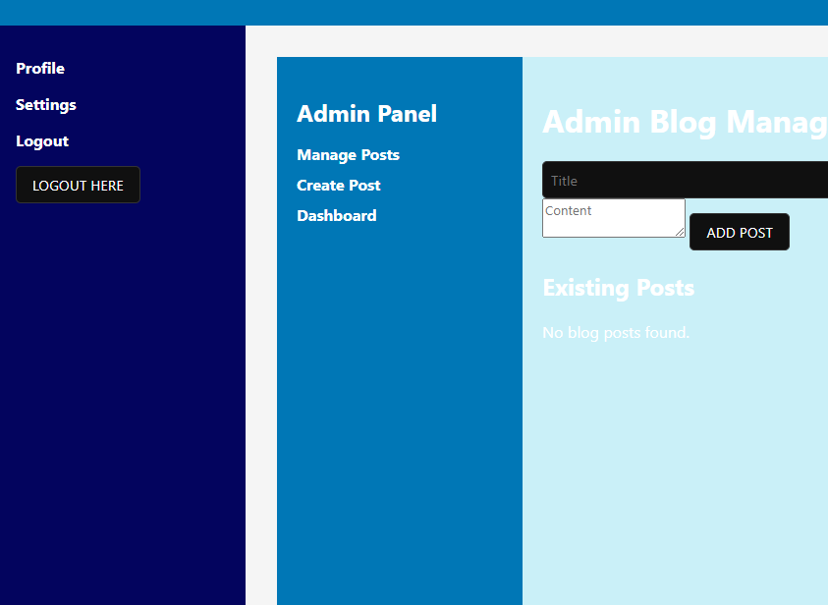
Nested Menus:
This was achieved by inheriting the layout into the child layout. Looks pretty funky and should be usable. Need to make it dynamic and changing.
Notes:
Looks like Layouts are inherited regardless. It is possible to break out of layouts, but this seems to be the natural

Slide 54

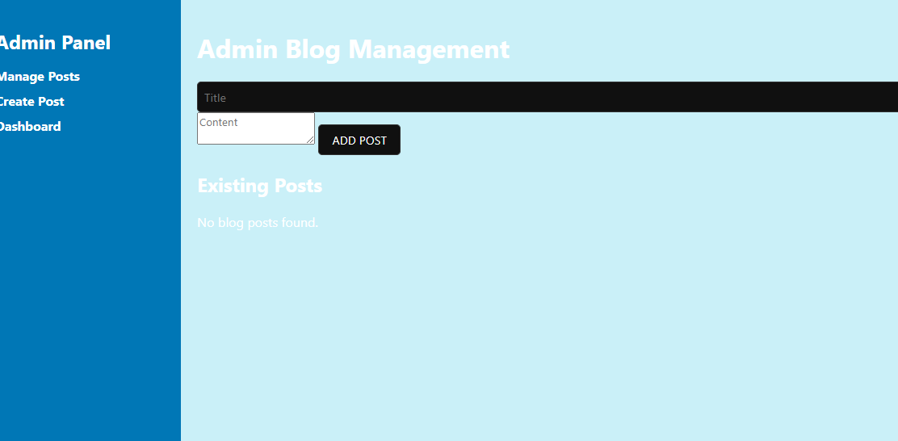
Blog:
Basic CRUD is working. But how to trake this to the next level. Look at Lissys blog and try to level mine up.

Slide 55
E-Commerce
Decisions around what is needed for a full-blown integration.
Some payment source ?
Receipts?
Tax invoice?
Email Confirmation?
Products + [slug]
Shopping cart -> DB account + local account. Conflicting carts?
Profile page ?
Card details?

Slide 56
Admin pages?
Protected routes?
APIs?
RBAC?
Blog update page ?
Product update page?
Orders page? + [slug]

